Slide 1
Sprint 3 : Cervical spine fracture detection
A1_10

Slide 2
Preprocessing part
How to show CT scans in ITK-SNAP? For a single CT scan ✅
Change window width and window level to better enhance the bones
How to show CT scans in Python? For batching CT scans ✅
DICOM: Convert all dicoms images to 3D volume ( .dcm --> .nzp) and interactively show some examples
Segmentation: Convert them to numpy format, clip the images within [-125, 175], normalize each 3D image to [0, 1], and extract 2D slices from 3D volume for training cases.
Problem: ❓
How to unify coordinates of DICOM and segmentation files? Using matrix?

Slide 3
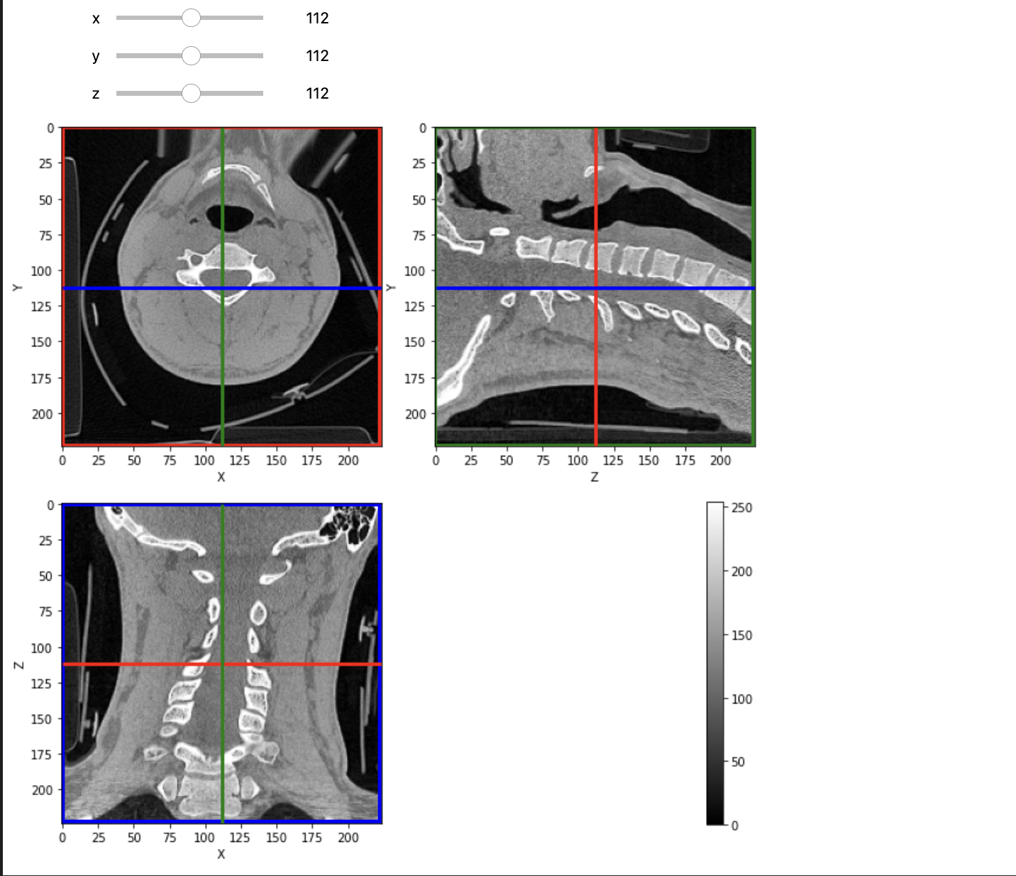
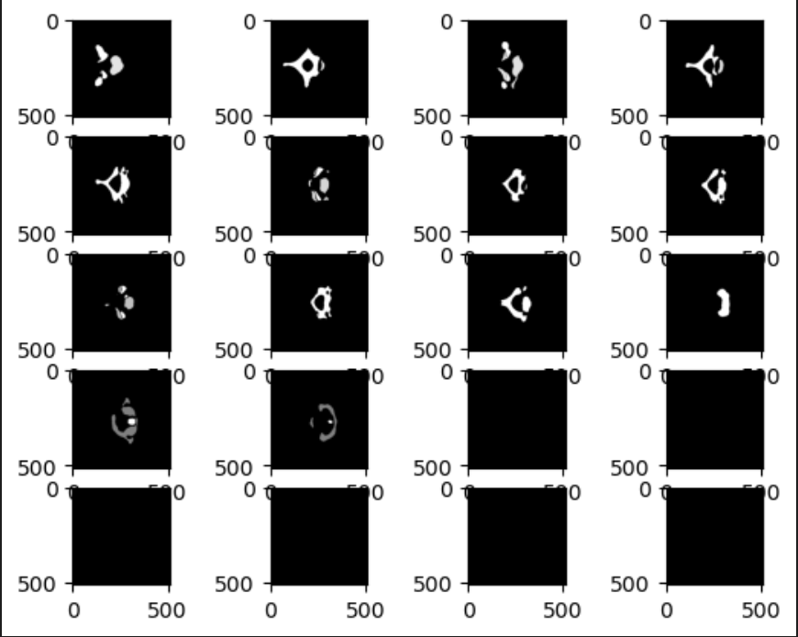

Slide 4
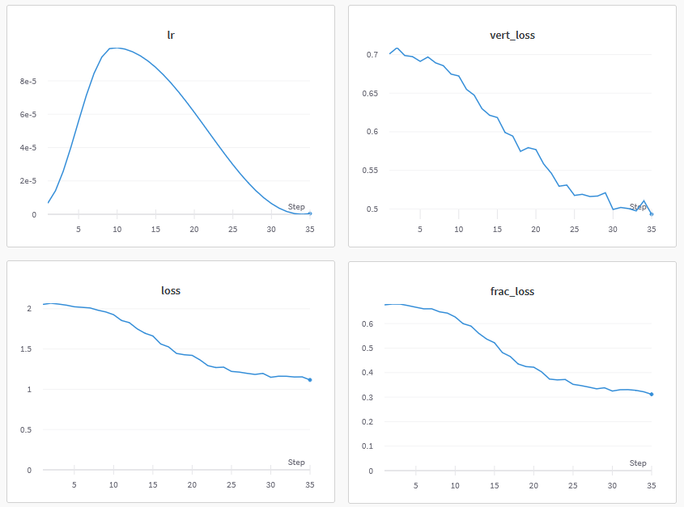
Model training
Trained our model on SCC
Used WanDB to sync and visualize the training progress
Implemented a EffcientNetV2 model based on Kaggle open source code

Slide 5
Next sprint goal
Design a UI based on PyQt5
Try different models(UNet, DenseNet…)
Evaluate the model performance on test dataset

